Slide 1
MASTERS IN PROJECT MANAGEMENT
PROJECT RISK
MANAGEMENT
Class: MS(PM)-2(A,B&C)

Slide 2
Instructor
Suhail Iqbal
PE, PMP, PgMP, PME, MCT, PRINCE2 Practitioner.
PE, PMP, PgMP, PME, MCT, PRINCE2 Practitioner.
Notes:
Custom animation effects: horizontal scrolling text
(Basic)
To reproduce the text effects on this slide, do the following:
On the Home tab, in the Slides group, click Layout, and then click Blank.
On the Insert tab, in the Text group, click Text Box, and then on the slide, drag to draw the text box.
Enter text in the text box. (Note: You may want to add a bullet point at the end of your text, as in the example above. On the Insert tab, in the Text group, click Symbol. In the Symbol dialog box, in the Font list, select (normal text). In the Subset list, select General Punctuation. In the Character Code box, enter 2022 to select BULLET, and then click Insert.)
Select the text. On the Home tab, in the Font group, do the following:
In the Font list, select Gill Sans MT.
In the Font Size list, select 36.
Click Bold.
Click the arrow next to Font Color, and then under Theme Colors click White, Background 1 (first row, first option from the left).
On the Home tab, in the Paragraph group, click Align Text Left to align the text left in the text box. (Note: If the text wraps to more than one line, drag the adjustment handles on the text box to widen it until the text fits on one line.)
Drag the text box to the left of the lower left edge of the slide. (Note: To see beyond the edges of the slide, on the View tab, click Zoom, and then in the Zoom dialog box, in the Percent box, enter 40%.)
To reproduce the animation effects on this slide, do the following:
On the Animations tab, in the Animations group, click Custom Animation.
On the slide, select the text box. In the Custom Animation task pane, do the following:
Click Add Effect, point to Entrance, and then click More Effects. In the Add Entrance Effect dialog box, under Basic, click Fly In.
Select the animation effect (fly-in effect for the text box). Click the arrow to the right of the select effect, and then click Effect Options. In the Fly In dialog box, do the following:
On the Effect tab, in the Direction list, select From Right.
On the Timing tab, do the following:
In the Start list, select With Previous.
In the Speed box, enter 16 seconds.
In the Repeat list, select Until End of Slide.
On the slide, select the text box. On the Home tab, in the Clipboard group, click the arrow under Paste, and then click Duplicate.
In the Custom Animation task pane, select the second animation effect (fly-in effect for the second text box). Click the arrow to the right of the selected effect, and then click Timing. In the Fly In dialog box, on the Timing tab, in the Delay box, enter 8. (Note: You may need to adjust the delay time if the length of your text is different than the example above.)
On the slide, drag the second text box on top of the first text box.
On the Home tab, in the Editing group, click Select, and then click Selection Pane.
In the Selection and Visibility pane, press and hold CTRL, and then select both text boxes. On the Home tab, in the Drawing group, click Arrange, point to Align, and then do the following:
Click Align Selected Objects.
Click Align Middle.
Click Align Center.
To reproduce the background effects on this slide, do the following:
Right-click the slide background area, and then click Format Background. In the Format Background dialog box, click Fill in the left pane, and then select Picture or texture fill in the Fill pane. Under Insert from, click File. In the Insert Picture dialog box, select a picture, and then click Insert.
On the Home tab, in the Drawing group, click Shapes, and then under Rectangles click Rectangle (first option from the left). On the slide, drag to draw a rectangle.
Select the rectangle. Under Drawing Tools, on the Format tab, in the Size group, do the following:
In the Shape Height box, enter 7.5”.
In the Shape Width box, enter 1”.
Under Drawing Tools, on the Format tab, in the Shape Styles group, click the arrow next to Shape Outline, and then click No Outline.
On the Home Tab, in the Drawing group, click the arrow next to Shape Fill, point to Gradient, and then click More Gradients. In the Format Shape dialog box, click Fill in the left pane, select Gradient fill in the Fill pane, and then do the following:
In the Type list, select Linear.
Click the button next to Direction, and then click Linear Right (first row, fourth option from the left).
Under Gradient stops, click Add or Remove until two stops appear in the drop-down list.
Also under Gradient stops, customize the gradient stops that you added as follows:
Select Stop 1 from the list, and then do the following:
In the Stop position box, enter 0%.
Click the button next to Color, and then under Theme Colors click Black, Text 1 (first row, second option from the left).
In the Transparency box, enter 0%.
Select Stop 2 from the list, and then do the following:
In the Stop position box, enter 100%.
Click the button next to Color, and then under Theme Colors click Black, Text 1, (first row, second option from the left).
In the Transparency box, enter 100%.
On the slide, select the rectangle. On the Home tab, in the Drawing group, click Arrange, point to Align, and then do the following:
Click Align to Slide.
Click Align Left.
Click Align Middle.
Select the rectangle. On the Home tab, in the Clipboard group, click the arrow under Paste, and then click Duplicate.
Select the duplicate rectangle. On the Home Tab, in the Drawing group, click the arrow next to Shape Fill, point to Gradient, and then click Linear Left (second row, third option from the left).
With the duplicate rectangle still selected, on the Home tab, in the Drawing group, click Arrange, point to Align, and then do the following:
Click Align to Slide.
Click Align Right.
Click Align Middle.

Slide 3
SYLLABUS
Unit | Content | Learning Objectives
8. Perform Qualitative Risk Analysis | Risk Assessment Goals Assessment Methodology Advantages of Assessment Methodology Purpose and Objective of the Perform Qualitative Risk Analysis Process Critical Success Factors for the Perform Qualitative Risk Analysis Process Tools & Techniques for the Perform Qualitative Risk Analysis Process Documenting the Results of the Perform Qualitative Risk Analysis Process | Understand the process of analyzing the identified risks, firstly by having a clear picture of Risk Assessment goals and methodology and then performing qualitative analysis of the risks using various Qualitative Risk Analysis Tools & Techniques.

Slide 4
UNIT 8
UNIT 8
PERFORM QUALITATIVE RISK aNALYSIS
PROJECT RISK
MANAGEMENT
Class: MS(PM)-2 (A,B&C)

Slide 5
PERFORM QUALITATIVE RISK ANALYSIS
LEARNING OBJECTIVE
UNIT 8
Understand the process of analyzing the identified risks, firstly by having a clear picture of Risk Assessment goals and methodology and then performing qualitative analysis of the risks using various Qualitative Risk Analysis Tools & Techniques.

Slide 6
PERFORM QUALITATIVE RISK ANALYSIS
CONTENT
UNIT 8
Risk Assessment Goals
Assessment Methodology
Advantages of Assessment Methodology
Purpose and Objective of the Perform Qualitative Risk Analysis Process
Critical Success Factors for the Perform Qualitative Risk Analysis Process
Tools & Techniques for the Perform Qualitative Risk Analysis Process
Documenting the Results of the Perform Qualitative Risk Analysis Process

Slide 7
PERFORM QUALITATIVE RISK ANALYSIS
RISK ASSESSMENT GOALS
UNIT 8
Increase the understanding of the project in general.
Identify the alternatives available in delivery and methods.
Ensure that uncertainties and risks are adequately considered in a structured and systematic way, which allows them to be incorporated into the planning and perfect development process.
Through direct examination of these uncertainties and risks, establish the implications of these on all other aspects of the project.
From Project and Program Risk Management, Max Wideman, PMI

Slide 8
PERFORM QUALITATIVE RISK ANALYSIS
MAJOR BENEFITS OF
RISK ASSESSMENT GOALS
UNIT 8
Greater information is made available during the course of project planning and decision making; e.g., estimates of uncertainty of project performance and viability should evolve.
The project objectives themselves may be called into question, and hence improved upon.
Improved communication between members of the project team, and other project stakeholders, where appropriate.
Confidence that the true implications of uncertainties and risk have been examined and incorporated into the project plans.
From Project and Program Risk Management, Max Wideman, PMI

Slide 9
PERFORM QUALITATIVE RISK ANALYSIS
MAJOR BENEFITS OF
RISK ASSESSMENT GOALS
UNIT 8
Documented support for the project contingency allowance; and a basis for its application management.
Reduced probability that the realization of the project will be sub-optimal, either by identifying weaknesses or by forcing improvements during the project planning phases.
Consequently, a reduced likelihood of disruptive changes during implementation.
Hence, substantially increased chances of project success.
From Project and Program Risk Management, Max Wideman, PMI

Slide 10
PERFORM QUALITATIVE RISK ANALYSIS
PROJECT RISK ASSESSMENT
UNIT 8
Properly handled, the risk assessment process should promote the language of probability and the use of its associated mathematics in risk analysis.
It is best handled by examining the individual elements of the project in some detail and determining their relationships, because most people are more able to comprehend the parts than the whole.
In a formal quantitative risk assessment, i.e., a risk impact analysis, a mathematical means is developed to integrate the complex relationships between the detailed elements of available information and the information possessed by numerous experts while preserving the experts’ uncertainty of opinion.
Remember, objective of project management is always to achieve project success through “participant satisfaction”.
From Project and Program Risk Management, Max Wideman, PMI

Slide 11
PERFORM QUALITATIVE RISK ANALYSIS
PROJECT RISK ASSESSMENT
UNIT 8
Since the long-term viability of the resulting product is often a key element of success, it may also be necessary to conduct a comprehensive product life cycle risk analysis during the conceptual phase of the project.
If the project is large and/or complex, the product has an extended life as in building and engineering works, or is part of an extended program of projects.
In this case, the project risk assessment, which essentially covers the functions of technical scope, quality, time and cost, may form part of this more comprehensive product risk analysis.
From Project and Program Risk Management, Max Wideman, PMI

Slide 12
PERFORM QUALITATIVE RISK ANALYSIS
ASSESSMENT METHODOLOGY
UNIT 8
SELECTION
Having identified possibly a large number of risks, which should receive attention.
No risk be ignored, but lesser risks be handled by contingency allowance.
Risk events are first categorized and then assessed for severity and probability, and later ranked by priority.
Assessment governed by risk management policies
Categorization be closely aligned with WBS.
Possibility of a significant impact as a result of some combination of apparently minor events must not be overlooked.
From Project and Program Risk Management, Max Wideman, PMI

Slide 13
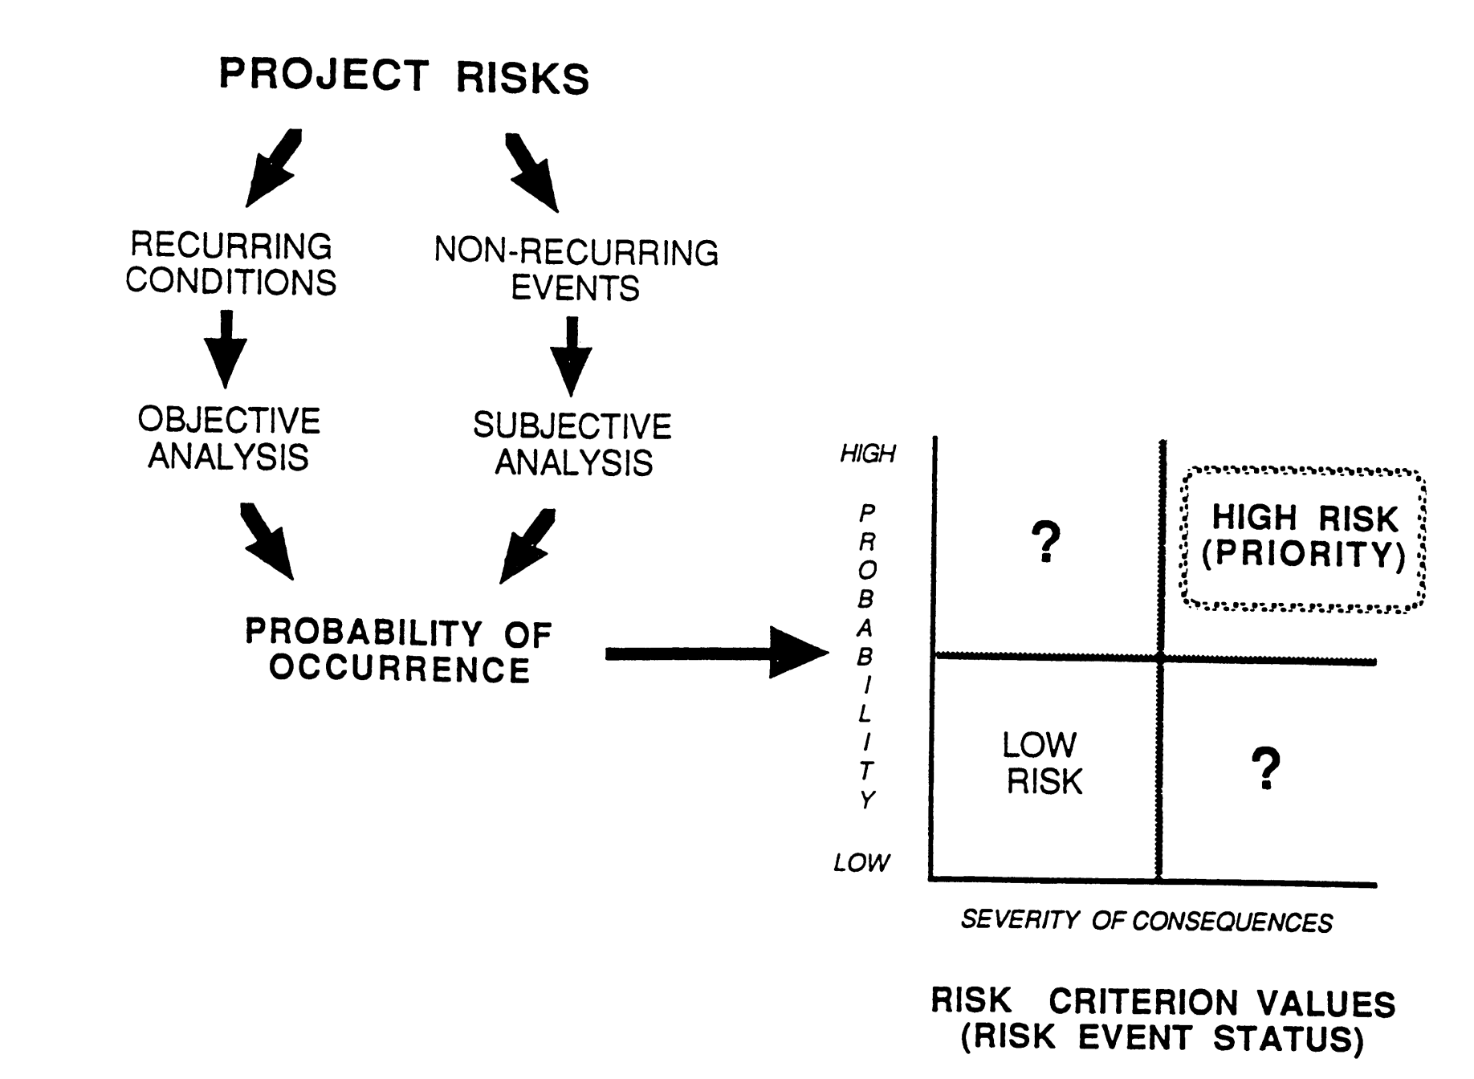
PERFORM QUALITATIVE RISK ANALYSIS
Comparing Severity of Project Risks
UNIT 8
From Project and Program Risk Management, Max Wideman, PMI

Slide 14
PERFORM QUALITATIVE RISK ANALYSIS
ASSESSMENT METHODOLOGY
UNIT 8
SIMPLE ASSESSMENT DEVELOPMENT
STEP I – Select the risk events, or series of related events, to be examined. Prioritize them.
STEP II – Assess the probability associated with the risk event(s).
STEP III – Assess the consequences and severity of the risk event(s).
STEP IV – Plan to mitigate the likelihood of the risk events, develop suitable responses, and contingency plans.
STEP V – Accumulate the results of the assessment in a set of “Conclusions and Recommendations.”
From Project and Program Risk Management, Max Wideman, PMI

Slide 15
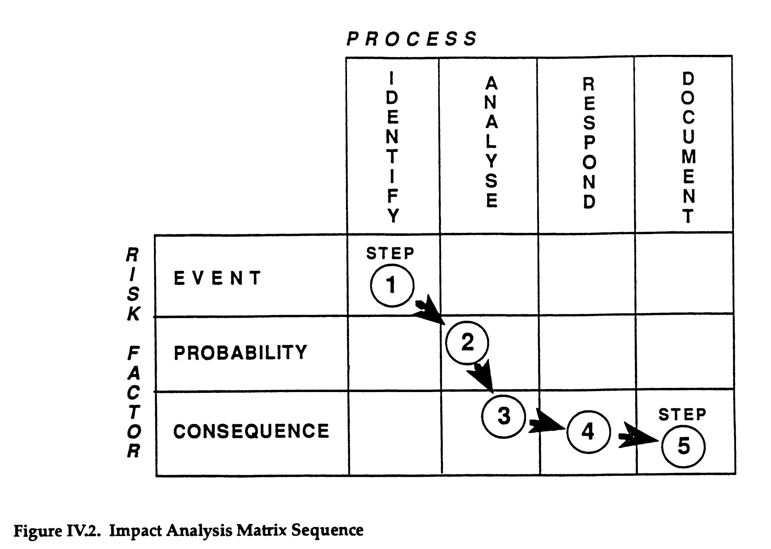
PERFORM QUALITATIVE RISK ANALYSIS
Impact Analysis Matrix Sequence
UNIT 8
From Project and Program Risk Management, Max Wideman, PMI

Slide 16
PERFORM QUALITATIVE RISK ANALYSIS
ASSESSMENT METHODOLOGY
UNIT 8
ADVANTAGES
Vehicle for incorporating uncertainties into the project management processes.
Clear understanding of overall project goals and objectives.
What the risks really are and which should get more attention.
Models and techniques available.
Order-of-magnitude data available.
More rational basis for contingency planning.
More consistent and workable project plan.
An early warning for risk.
From Project and Program Risk Management, Max Wideman, PMI

Slide 17
PERFORM QUALITATIVE RISK ANALYSIS
Purpose and Objectives
UNIT 8
Assess and evaluates characteristics of individually identified project risks and prioritizes risks based on agreed-upon characteristics.
Evaluates the probability that each risk will occur and the effect of each individual risk on the project objectives.
Does not directly address the overall risk to project objectives that results from the combined effect of all risks and their potential interactions with each other.
From Practice Standard for Project Risk Management, 1st Ed, PMI

Slide 18
PERFORM QUALITATIVE RISK ANALYSIS
Objectives
UNIT 8
Subjectively evaluate the probability and impact of each risk.
Create a shorter list of risks by determining the top or critical risks that you will quantify further and/or plan risk responses.
Make a Go/No-Go decision
From Rita Mulcahy’s Risk Management – Tricks of the Trade for Project Managers, and PMI-RMP® Exam Prep Guide, 2nd Ed

Slide 19
PERFORM QUALITATIVE RISK ANALYSIS
Purpose
UNIT 8
Determine Additional Information needed
Ask the experts/customers any questions not answered already.
Review supplied data in light of Identified Risks.
Determine Frequency and Timing
When a risk might occur in project life cycle
How often
Risk which occurs later should be rated higher
Risk impacting important part of project
Risk that occurs more than once - response
From Rita Mulcahy’s Risk Management – Tricks of the Trade for Project Managers, and PMI-RMP® Exam Prep Guide, 2nd Ed

Slide 20
PERFORM QUALITATIVE RISK ANALYSIS
Assumptions Testing
UNIT 8
Assumptions made when determining risks.
Too many guesses makes the data unreliable.
Look at the stability of each assumption.
Assumption | Stability (1 to 10) | Consequence if False (1 to 10)
Project work will not interface with Naseem’s daily work. | 2 | 8
From Rita Mulcahy’s Risk Management – Tricks of the Trade for Project Managers, and PMI-RMP® Exam Prep Guide, 2nd Ed

Slide 21
PERFORM QUALITATIVE RISK ANALYSIS
Data Quality Assessment
UNIT 8
Extent of the understanding of the risk
Amount of data available about the risk
Reliability and integrity of the data
Risk | Extent of understanding of the risk | Availability of Data about the risk | Reliability of data
The XYZ system will arrive late, causing a 2-week delay. | 9 | 7 | 2
Software will not be comparable with operating system resulting in need for new software | 2 | 2 | 9
From Rita Mulcahy’s Risk Management – Tricks of the Trade for Project Managers, and PMI-RMP® Exam Prep Guide, 2nd Ed

Slide 22
PERFORM QUALITATIVE RISK ANALYSIS
Inputs
UNIT 8
Risk Management Plan
Risk Register
Project Scope Statement
Project type and an understanding of the work needed to complete the project.
Data about the risks to measure their precision
Assumptions to test
Scales of probability and impact
Historical Records
From Rita Mulcahy’s Risk Management – Tricks of the Trade for Project Managers, and PMI-RMP® Exam Prep Guide, 2nd Ed

Slide 24
8
2
Perform Qualitative Risk Analysis
Risk
Planning
Process 11.3
Process of prioritizing risks for further analysis or action by assessing and combining their probability of occurrence and impact.
11.3
Inputs
1
Tools and Techniques
2
Outputs
3
Risk Register
Risk Management Plan
Project Scope Statement
Organizational Process Assets
____________
Risk Probability and Impact Assessment
Probability and Impact Matrix
Risk Data Quality Assessment
Risk Categorization
Risk Urgency Assessment
Expert Judgment
___________
Risk Register Updates
____________
Reference: Figure 11.8.
PMBOK® Guide, 4th Ed
Notes:
Picture with three text columns
(Intermediate)
To reproduce the picture effects on this slide, do the following:
On the Home tab, in the Slides group, click Layout, and then click Blank.
On the Insert tab, in the Illustrations group, click Picture.
In the Insert Picture dialog box, select a picture and then click Insert.
Select the picture. Under Picture Tools, on the Format tab, in the bottom right corner of the Size group, click the Size and Position dialog box launcher.
In the Size and Position dialog box, on the Size tab, resize or crop the picture as needed so that under Size and rotate, the Height box is set to 1.48” and the Width box is set to 9.17”. Resize the picture under Size and rotate by entering values into the Height and Width boxes. Crop the picture under Crop from by entering values into the Left, Right, Top, and Bottom boxes.
On the Home tab, in the bottom right corner of the Drawing group, click the Format Shape dialog box launcher. In the Format Shape dialog box, click Line Color in the left pane, select Gradient line in the right pane, and then do the following:
In the Type list, select Linear.
Click the button next to Direction, and then click Linear Up (second row, second option from the left).
Under Gradient stops, click Add or Remove until two stops appear in the drop-down list.
Also under Gradient stops, customize the gradient stops that you added as follows:
Select Stop 1 from the list, and then do the following:
In the Stop position box, enter 0%.
Click the button next to Color, and then under Theme Colors click White, Background 1 (first row, first option from the left).
Select Stop 2 from the list, and then do the following:
In the Stop position box, enter 100%.
Click the button next to Color, and then under Theme Colors click White, Background 1, Darker 25% (fourth row, first option from the left).
Also in the Format Shape dialog box, click Line Style in the left pane, and then in the right pane, in the Width box, enter 1 pt.
On the Home tab, in the Drawing group, click Shape Effects, point to Glow, and then do the following:
Under Glow Variations, select any option in the first row (5 pt glow options).
Point to More Glow Colors, and then under Theme Colors click White, Background 1, Darker 25% (fourth row, first option from the left).
On the Home tab, in the Drawing group, click Arrange, point to Align, and then click Align Center.
To reproduce the first column heading on this slide, do the following:
On the Home tab, in the Drawing group, click Shapes, and then under Rectangles, click Rectangle (first option from the left). On the slide, drag to draw a rectangle.
Under Drawing Tools, on the Format tab, in the Size group, do the following:
In the Shape Height box, enter 1”.
In the Shape Width box, enter 2.92”.
On the Home tab, in the bottom right corner of the Drawing group, click the Format Shape dialog box launcher. In the Format Shape dialog box, click Fill in the left pane, select Gradient fill in the right pane, and then do the following:
In the Type list, select Linear.
Click the button next to Direction, and then click Linear Down (first row, second option from the left).
Under Gradient stops, click Add or Remove until two stops appear in the drop-down list.
Also under Gradient stops, customize the gradient stops that you added as follows:
Select Stop 1 from the list, and then do the following:
In the Stop position box, enter 32%.
Click the button next to Color, and then under Theme Colors click Tan, Background 2 (first row, third option from the left).
Select Stop 2 from the list, and then do the following:
In the Stop position box, enter 100%.
Click the button next to Color, and then under Theme Colors click Tan, Background 2, Darker 25% (third row, third option from the left).
Also in the Format Shape dialog box, click Line Color in the left pane, select Gradient line in the Line Color pane, and then do the following:
In the Type list, select Linear.
Click the button next to Direction, and then click Linear Up (second row, second option from the left).
Under Gradient stops, click Add or Remove until two stops appear in the drop-down list.
Also under Gradient stops, customize the gradient stops that you added as follows:
Select Stop 1 from the list, and then do the following:
In the Stop position box, enter 0%.
Click the button next to Color, and then under Theme Colors click White, Background 1 (first row, first option from the left).
Select Stop 2 from the list, and then do the following:
In the Stop position box, enter 100%.
Click the button next to Color, and then under Theme Colors click White, Background 1, Darker 25% (fourth row, first option from the left).
Also in the Format Shape dialog box, click Line Style in the left pane. In the right pane, in the Width box, enter 1 pt.
On the Home tab, in the Drawing group, click Shape Effects, point to Glow, and then do the following:
Under Glow Variations, select any option in the first row (5 pt glow options).
Point to More Glow Colors, and then under Theme Colors click White, Background 1, Darker 25% (fourth row, first option from the left).
On the slide, right-click the rectangle and then click Edit Text.
Enter text in the text box and select the text. On the Home tab, in the Font group, select Gill Sans MT from the Font list and then select 24 from the Font Size list.
On the Home tab, in the Paragraph group, click Align Text Left to align the text left within the text box.
Under Drawing Tools, on the Format tab, in the WordArt Styles group, click the arrow next to Text Fill, and then under Theme Colors click Tan, Background 2, Darker 75% (fifth row, third option from the left).
On the Home tab, in the bottom-right corner of the Drawing group, click the Format Shapes dialog box launcher. In the Format Shapes dialog box, click Text Box in the left pane. In the right pane, under Internal margin, enter 1” in the Left box to increase the left margin in the rectangle to accommodate the embossed number.
On the Home tab, in the Drawing group, click Shapes, and then under Lines, click Line (first option from the left).
Press and hold SHIFT, and then on the slide, drag to draw a straight, vertical line.
Under Drawing Tools, on the Format tab, in the Size group, in the Width box, enter 0.75”.
On the Home tab, in the bottom-right corner of the Drawing group, click the Format Shapes dialog box launcher. In the Format Shapes dialog box, click Line Style in the left pane, and then do the following in the right pane:
In the Width box, enter 2.25 pt.
Click the button next to Dash type, and then click Round Dot (second option from the top).
Also in the Format Shapes dialog box, click Line Color in the left pane. In the right pane, click the button next to Color, and then under Theme Colors click White, Background 1 (first row, first option from the left).
On the slide, drag the line onto the rectangle, just left of the text box.
On the Insert tab, in the Text box, click Text Box and then on the slide, drag to draw another text box.
Enter 1 in the text box and select the text. On the Home tab, in the Font group, select Calisto MT from the Font list and then enter 50 in the Font Size box.
On the Home tab, in the Paragraph group, click Center to center the text within the text box.
Under Drawing Tools, on the Format tab, in the WordArt Styles group, click the arrow next to Text Fill, and then under Theme Colors click Tan, Background 2, Darker 25% (third row, third option from the left).
Drag the text box onto the rectangle, left of the dotted vertical line.
On the Home tab, in the Editing group, click Select, and then click Selection Pane.
In the Selection and Visibility pane, press and hold CTRL to select the text box, line, and rectangle.
On the Home tab, in the Drawing group, click Arrange, point to Align, and then click Align Middle.
To reproduce the other column headings on this slide, do the following:
On the Home tab, in the Editing group, click Select, and then click Selection Pane.
In the Selection and Visibility pane, press and hold CTRL to select the text box, line, and rectangle.
On the Home tab, in the Drawing group, click Arrange, and then under Group Objects click Group.
On the Home tab, in the Clipboard group, click the arrow under Paste, and then click Duplicate. Repeat the process until you have a total of three groups of shapes.
Select each group in the Selection and Visibility pane and drag it on the slide to form a row under the picture.
Also in the Selection and Visibility pane, press and hold CTRL and select all three groups. On the Home tab, in the Drawing group, click Arrange, point to Align, and then do the following:
Click Align Middle.
Click Distribute Horizontally.
To change the numbers in the duplicate text boxes (second and third from the left), click in each text box and edit the text.
To reproduce the first column (the “subtext” portion) on this slide, do the following:
On the Home tab, in the Drawing group, click Shapes, and then under Rectangles click Rectangle (first option from the left).
On the slide, drag to draw the rectangle so that the top edge is just below the first column heading and the bottom edge is at the bottom of the slide.
Under Drawing Tools, on the Format tab, in the Size group, in the Shape Width box, enter 2.92” so that the subtext column is the same width as the column heading above it.
On the Home tab, in the Drawing group, click the arrow next to Shape Outline, and then click No Outline.
On the Home tab, in the bottom right corner of the Drawing group, click the Format Shape dialog box launcher. In the Format Shape dialog box, click Fill in the left pane, select Gradient fill in the right pane, and then do the following:
In the Type list, select Linear.
Click the button next to Direction, and then click Linear Down (first row, second option from the left).
Under Gradient stops, click Add or Remove until three stops appear in the drop-down list.
Also under Gradient stops, customize the gradient stops that you added as follows:
Select Stop 1 from the list, and then do the following:
In the Stop position box, enter 0%.
Click the button next to Color, and then under Theme Colors click White, Background 1 (first row, first option from the left).
In the Transparency box, enter 100%.
Select Stop 2 from the list, and then do the following:
In the Stop position box, enter 50%.
Click the button next to Color, and then under Theme Colors click Tan, Background 2, Darker 25% (third row, third option from the left).
In the Transparency box, enter 25%.
Select Stop 3 from the list, and then do the following:
In the Stop position box, enter 100%.
Click the button next to Color, and then under Theme Colors click White, Background 1 (first row, first option from the left).
In the Transparency box, enter 100%.
On the slide, right-click the column and then click Edit Text.
Enter text in the text box and select the text. On the Home tab, in the Font group, select Gill Sans MT from the Font list and then enter 22 in the Font Size box.
On the Home tab, in the Paragraph group, click Center to center the text within the rectangle.
Under Drawing Tools, on the Format tab, in the WordArt Styles group, click the arrow next to Text Fill, and then under Theme Colors click White, Background 1, Darker 50% (sixth row, first option from the left).
On the Home tab, in the bottom-right corner of the Drawing group, click the Format Shapes dialog box launcher. In the Format Shapes dialog box, click Text Box in the left pane. In the right pane, under Text layout, in the Vertical Alignment list, select Top.
To reproduce the other columns (the “subtext” portion) on this slide, do the following:
Select the first “subtext” rectangle. On the Home tab, in the Clipboard group, click the arrow under Paste, and then click Duplicate. Repeat the process until you have a total of three “subtext” rectangles.
Drag each duplicate on the slide to form a row under the “text heading” rectangles.
Press and hold SHIFT and select all three “subtext” rectangles. On the Home tab, in the Drawing group, click Arrange, point to Align, and then click Distribute Horizontally.
To reproduce the background on this slide, do the following:
Right-click the slide background area, and then click Format Background. In the Format Background dialog box, click Fill in the left pane, select Gradient fill in the right pane, and then do the following:
In the Type list, select Radial.
Click the button next to Direction, and then click From Center (third option from the left).
Under Gradient stops, click Add or Remove until two stops appear in the drop-down list.
Also under Gradient stops, customize the gradient stops that you added as follows:
Select Stop 1 from the list, and then do the following:
In the Stop position box, enter 0%.
Click the button next to Color, and then under Theme Colors click White, Background 1 (first row, first option from the left).
Select Stop 2 from the list, and then do the following:
In the Stop position box, enter 100%.
Click the button next to Color, and then under Theme Colors click Tan, Background 2 (first row, third option from the left).

Slide 25
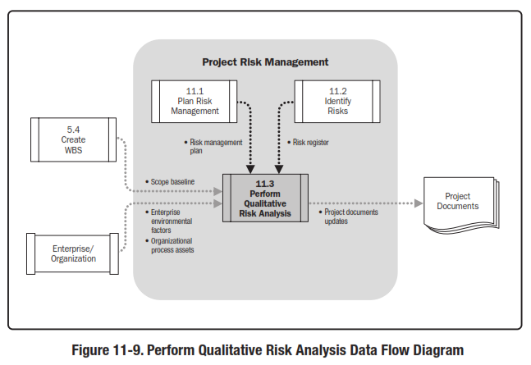
Perform Qualitative Risk Analysis
Reference: Figure 11.9.
PMBOK® Guide, 5th Ed

Slide 26
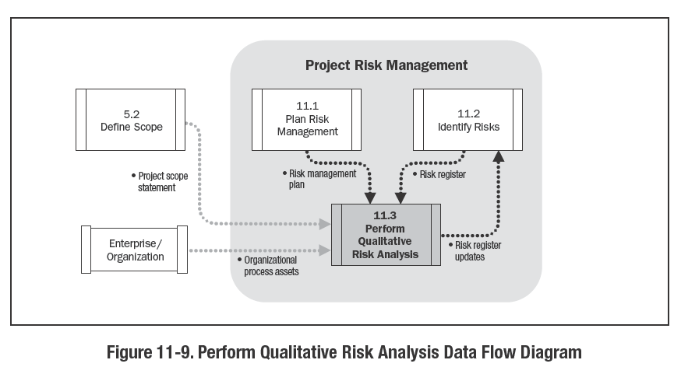
Reference: Figure 11.9.
PMBOK® Guide, 4th Ed

Slide 27
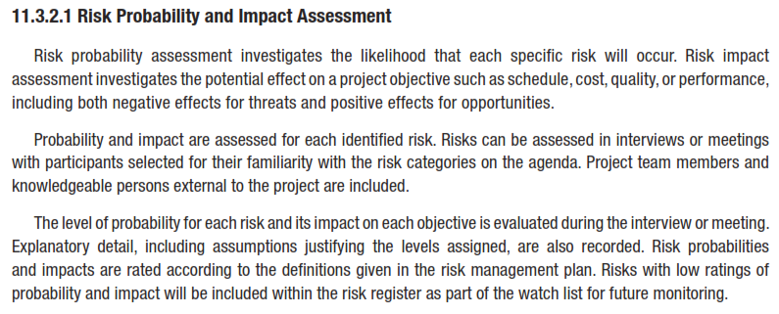
RISK PROBABILITY
AND
IMPACT ASSESSMENT

Slide 28
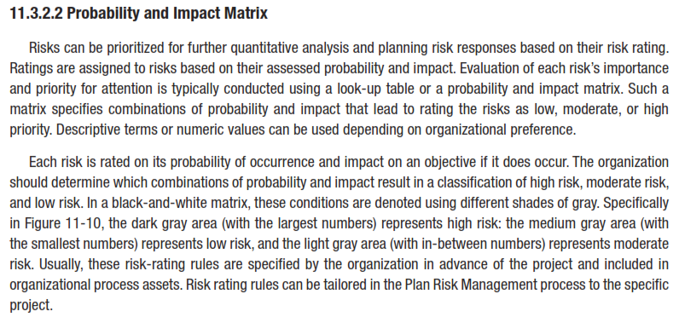
PROBABILITY
AND
IMPACT MATRIX

Slide 29
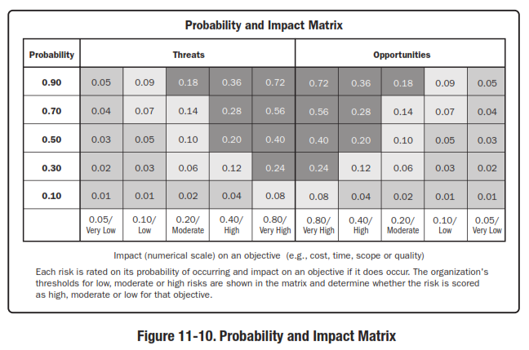
PROBABILITY AND IMPACT MATRIX

Slide 30
RISK DATA QUALITY ASSESSMENT

Slide 31
RISK CATEGORIZATION

Slide 32
RISK URGENCY ASSESSMENT

Slide 33
UNIT 8
PERFORM QUALITATIVE RISK ANALYSIS
Critical Success Factors

Slide 34
PERFORM QUALITATIVE RISK ANALYSIS
Critical Success Factors
6.2.1 Use Agreed Upon Approach
UNIT 8
Can be applied across all of the identified risks in any project.
All risks may be assessed by probability and impact
Other factors to consider importance of risks
Urgency (proximity) – near term response URGENT
Manageability
Go forward – establish contingency reserve
Stop or re-scope – Unmanageable
Inform customer and ask for decision
Impact external to the project
From Practice Standard for Project Risk Management, 1st Ed, PMI
Notes:
ROLE OF PROJECT RISK MGMT
In Corporate Business Management
Two Basic Types in Corporate Business Management:-
Business Risk
Inherent chances of both profit and loss associated with the particular business endeavor.
Business entities employ skilled staff to increase the chances of profit and reduce the chances of loss.
The essential purpose is to maximize profits.
Pure or Insurable Risk
Involves only a chance for loss and no chance for profit.
Insurable risks can be further sub-divided into four categories:-
Direct property loss
Indirect property loss
Liability loss
Personal loss

Slide 35
PERFORM QUALITATIVE RISK ANALYSIS
Critical Success Factors
6.2.2 Use Agreed Upon Definitions
UNIT 8
Should be based on agreed-upon definitions of risk terms.
Should be used consistently when assessing each risk.
Assists information provider in giving realistic assessments for each risk.
Facilitates the communication of the results to management and other stakeholders.
From Practice Standard for Project Risk Management, 1st Ed, PMI
Notes:
ROLE OF PROJECT RISK MGMT
In Corporate Business Management
Two Basic Types in Corporate Business Management:-
Business Risk
Inherent chances of both profit and loss associated with the particular business endeavor.
Business entities employ skilled staff to increase the chances of profit and reduce the chances of loss.
The essential purpose is to maximize profits.
Pure or Insurable Risk
Involves only a chance for loss and no chance for profit.
Insurable risks can be further sub-divided into four categories:-
Direct property loss
Indirect property loss
Liability loss
Personal loss

Slide 36
PERFORM QUALITATIVE RISK ANALYSIS
Critical Success Factors
6.2.3 Collect High-Quality Information about Risks
UNIT 8
Collection of High-quality information about risks is required.
Information not available in historic database be gathered by interviews, workshops, and other means using expert judgment.
Data gathered from individuals may be subject to reporting or intentional bias.
Bias should be identified and remedied where possible. Or a different unbiased source of information be found and used.
From Practice Standard for Project Risk Management, 1st Ed, PMI
Notes:
ROLE OF PROJECT RISK MGMT
In Corporate Business Management
Two Basic Types in Corporate Business Management:-
Business Risk
Inherent chances of both profit and loss associated with the particular business endeavor.
Business entities employ skilled staff to increase the chances of profit and reduce the chances of loss.
The essential purpose is to maximize profits.
Pure or Insurable Risk
Involves only a chance for loss and no chance for profit.
Insurable risks can be further sub-divided into four categories:-
Direct property loss
Indirect property loss
Liability loss
Personal loss

Slide 37
PERFORM QUALITATIVE RISK ANALYSIS
Critical Success Factors
6.2.4 Perform Iterative Qualitative Risk Analysis
UNIT 8
Process be used periodically throughout the project.
Impossible to know all risks in advance.
Identify Risks and Perform Qualitative Risk Analysis iteratively.
Frequency of effort will be planned in Plan Project management process.
May also depend on events within the project itself.
From Practice Standard for Project Risk Management, 1st Ed, PMI
Notes:
ROLE OF PROJECT RISK MGMT
In Corporate Business Management
Two Basic Types in Corporate Business Management:-
Business Risk
Inherent chances of both profit and loss associated with the particular business endeavor.
Business entities employ skilled staff to increase the chances of profit and reduce the chances of loss.
The essential purpose is to maximize profits.
Pure or Insurable Risk
Involves only a chance for loss and no chance for profit.
Insurable risks can be further sub-divided into four categories:-
Direct property loss
Indirect property loss
Liability loss
Personal loss

Slide 38
UNIT 8
PERFORM QUALITATIVE RISK ANALYSIS
Tools and Techniques

Slide 39
PERFORM QUALITATIVE RISK ANALYSIS
Tools and Techniques
UNIT 8
6.3.1 Select Risk Characteristics
6.3.2 Collect and Analyze Data
6.3.3 Prioritize Risks by Probability and Impact on Specific Objectives
6.3.4 Prioritize Risks by Probability and Impact on Overall Project
6.3.5 Categorize Risk Causes
6.3.6 Document the Results of the Perform Qualitative Risk Analysis Process
From Practice Standard for Project Risk Management, 1st Ed, PMI
Notes:
ROLE OF PROJECT RISK MGMT
In Corporate Business Management
Two Basic Types in Corporate Business Management:-
Business Risk
Inherent chances of both profit and loss associated with the particular business endeavor.
Business entities employ skilled staff to increase the chances of profit and reduce the chances of loss.
The essential purpose is to maximize profits.
Pure or Insurable Risk
Involves only a chance for loss and no chance for profit.
Insurable risks can be further sub-divided into four categories:-
Direct property loss
Indirect property loss
Liability loss
Personal loss

Slide 40
PERFORM QUALITATIVE RISK ANALYSIS
Tools and Techniques
6.3.1 Select Risk Characteristics
UNIT 8
Separate risks important for response.
Criteria of interest agreed upon.
List of risks in priority order or priority groups (high, moderate and low).
Tools allow organization/project stakeholders to specify those levels and combination of risk characteristics to specify particular risk of interest to management.
From Practice Standard for Project Risk Management, 1st Ed, PMI
Notes:
ROLE OF PROJECT RISK MGMT
In Corporate Business Management
Two Basic Types in Corporate Business Management:-
Business Risk
Inherent chances of both profit and loss associated with the particular business endeavor.
Business entities employ skilled staff to increase the chances of profit and reduce the chances of loss.
The essential purpose is to maximize profits.
Pure or Insurable Risk
Involves only a chance for loss and no chance for profit.
Insurable risks can be further sub-divided into four categories:-
Direct property loss
Indirect property loss
Liability loss
Personal loss

Slide 41
PERFORM QUALITATIVE RISK ANALYSIS
Tools and Techniques
6.3.2 Collect and Analyze Data
UNIT 8
Based on information collected.
For use of Data Collection and Evaluation Tools, require management support and attention.
Protect against bias in data gathering, when relying on expert judgment.
From Practice Standard for Project Risk Management, 1st Ed, PMI
Notes:
ROLE OF PROJECT RISK MGMT
In Corporate Business Management
Two Basic Types in Corporate Business Management:-
Business Risk
Inherent chances of both profit and loss associated with the particular business endeavor.
Business entities employ skilled staff to increase the chances of profit and reduce the chances of loss.
The essential purpose is to maximize profits.
Pure or Insurable Risk
Involves only a chance for loss and no chance for profit.
Insurable risks can be further sub-divided into four categories:-
Direct property loss
Indirect property loss
Liability loss
Personal loss

Slide 42
PERFORM QUALITATIVE RISK ANALYSIS
Tools and Techniques
6.3.3 Prioritize Risks - Specific
UNIT 8
Some tools permit distinguishing a risk’s priority in terms of the affected objective.
Provides a list of risks that are important for any specific objective of interest to management.
Common for risks to have uneven impacts on various project objectives.
From Practice Standard for Project Risk Management, 1st Ed, PMI
Notes:
ROLE OF PROJECT RISK MGMT
In Corporate Business Management
Two Basic Types in Corporate Business Management:-
Business Risk
Inherent chances of both profit and loss associated with the particular business endeavor.
Business entities employ skilled staff to increase the chances of profit and reduce the chances of loss.
The essential purpose is to maximize profits.
Pure or Insurable Risk
Involves only a chance for loss and no chance for profit.
Insurable risks can be further sub-divided into four categories:-
Direct property loss
Indirect property loss
Liability loss
Personal loss

Slide 43
PERFORM QUALITATIVE RISK ANALYSIS
Tools and Techniques
6.3.4 Prioritize Risks - Specific
UNIT 8
Measure of a specific risk’s importance to the entire project.
Ease of communication with management and stakeholders.
If a single risk prioritization index needed, explicitly define how to create.
Index represents organization’s preference among objectives.
Technique for creating the overall risk priority measure should be documented in Plan Risk Management process.
From Practice Standard for Project Risk Management, 1st Ed, PMI
Notes:
ROLE OF PROJECT RISK MGMT
In Corporate Business Management
Two Basic Types in Corporate Business Management:-
Business Risk
Inherent chances of both profit and loss associated with the particular business endeavor.
Business entities employ skilled staff to increase the chances of profit and reduce the chances of loss.
The essential purpose is to maximize profits.
Pure or Insurable Risk
Involves only a chance for loss and no chance for profit.
Insurable risks can be further sub-divided into four categories:-
Direct property loss
Indirect property loss
Liability loss
Personal loss

Slide 44
PERFORM QUALITATIVE RISK ANALYSIS
Tools and Techniques
6.3.5 Categorize Risk Causes
UNIT 8
May lead to improved analysis of probability and magnitude of risk and to effective responses.
Identifying common root causes of a group of risks.
Understanding the chain of risks.
Risks that can occur simultaneously use same resources.
Combine results with Risk Breakdown Structure.
Combine with WBS to determine risky areas of project.
Assessing high-priority risks on one objective.
Can contribute to realism and usefulness.
From Practice Standard for Project Risk Management, 1st Ed, PMI
Notes:
ROLE OF PROJECT RISK MGMT
In Corporate Business Management
Two Basic Types in Corporate Business Management:-
Business Risk
Inherent chances of both profit and loss associated with the particular business endeavor.
Business entities employ skilled staff to increase the chances of profit and reduce the chances of loss.
The essential purpose is to maximize profits.
Pure or Insurable Risk
Involves only a chance for loss and no chance for profit.
Insurable risks can be further sub-divided into four categories:-
Direct property loss
Indirect property loss
Liability loss
Personal loss

Slide 45
PERFORM QUALITATIVE RISK ANALYSIS
Tools and Techniques
6.3.6 Document the Results
UNIT 8
Adds structure to the list of undifferentiated risks.
Priority assignment and recording in risk register.
High priority risks segregated for further analysis.
Low priority may be placed on watch list and reviewed often for changes in their status.
From Practice Standard for Project Risk Management, 1st Ed, PMI
Notes:
ROLE OF PROJECT RISK MGMT
In Corporate Business Management
Two Basic Types in Corporate Business Management:-
Business Risk
Inherent chances of both profit and loss associated with the particular business endeavor.
Business entities employ skilled staff to increase the chances of profit and reduce the chances of loss.
The essential purpose is to maximize profits.
Pure or Insurable Risk
Involves only a chance for loss and no chance for profit.
Insurable risks can be further sub-divided into four categories:-
Direct property loss
Indirect property loss
Liability loss
Personal loss

Slide 46
UNIT 7
Review Questions

Slide 47
The End
THE END
THANK YOU

